Slide 1
HubOne Template Manager
Creating Document Templates integrated with Xero Practice Manager

Slide 2
Introduction
What is The HubOne Template Manager?
A SharePoint App which enables the automatic creation of documents by merging a document template with data from Xero Practice Manager.
Who uses it?
All customers who have The Modern Practice Portal.
Notes:
The HubOne Template Manager is a SharePoint App that facilitates powerful and easy integration between Document Templates and Xero Practice Manager client data, enabling the automatic creation of standardised company letters and documents. The App is designed for customers who have The Modern Practice Portal.

Slide 3
Champion Guide
Creating Document Templates
Notes:
The Champion Guide is for people who will be creating Document Templates based on standardised documents and letters for their organisations. These will be created on their Modern Practice Portal using the HubOne Template Manager integrating client data from Xero Practice Manager.

Slide 4
Agenda 1
Creating a Document Template
Inserting Fields
Field Types
Custom Fields
Saving your Document Template to SharePoint
Opening the Document Template in SharePoint

Slide 5
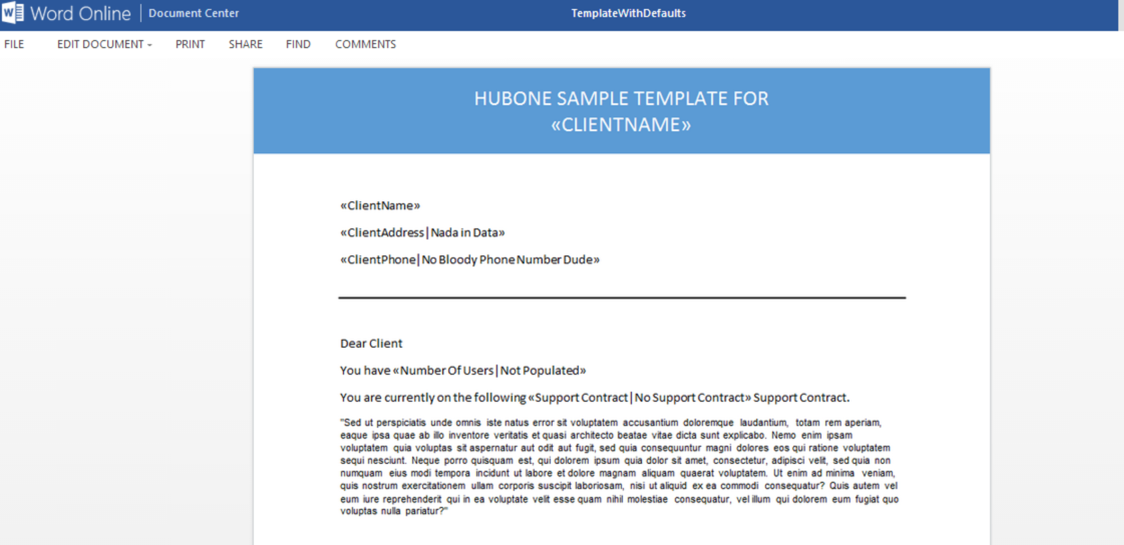
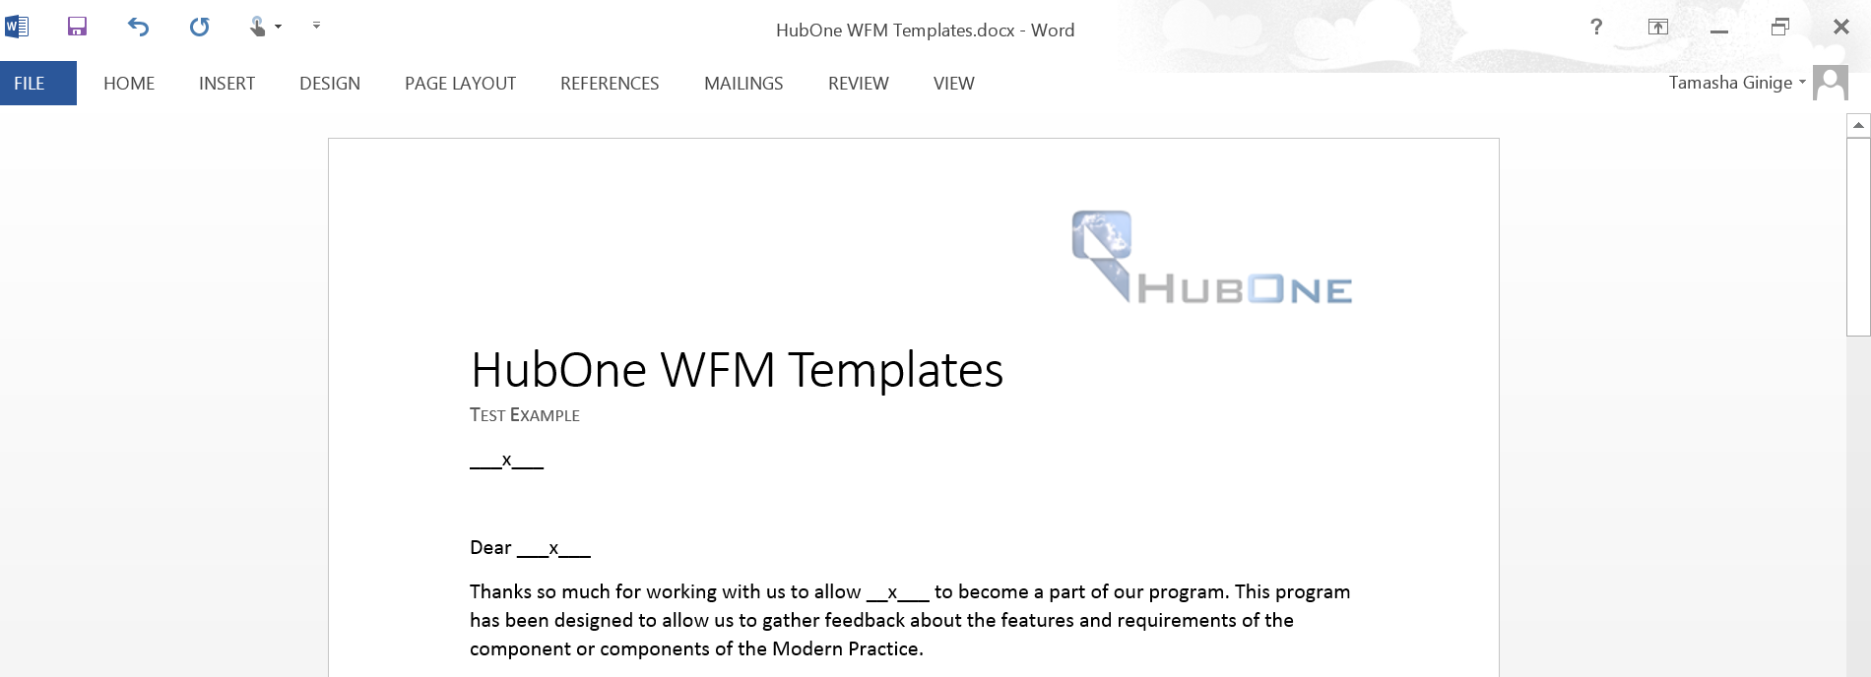
Creating a Document Template
Notes:
Open a new Word Document
Create a blank document
Add the Content, Headers and Footers and design the document to suit your requirements.

Slide 6
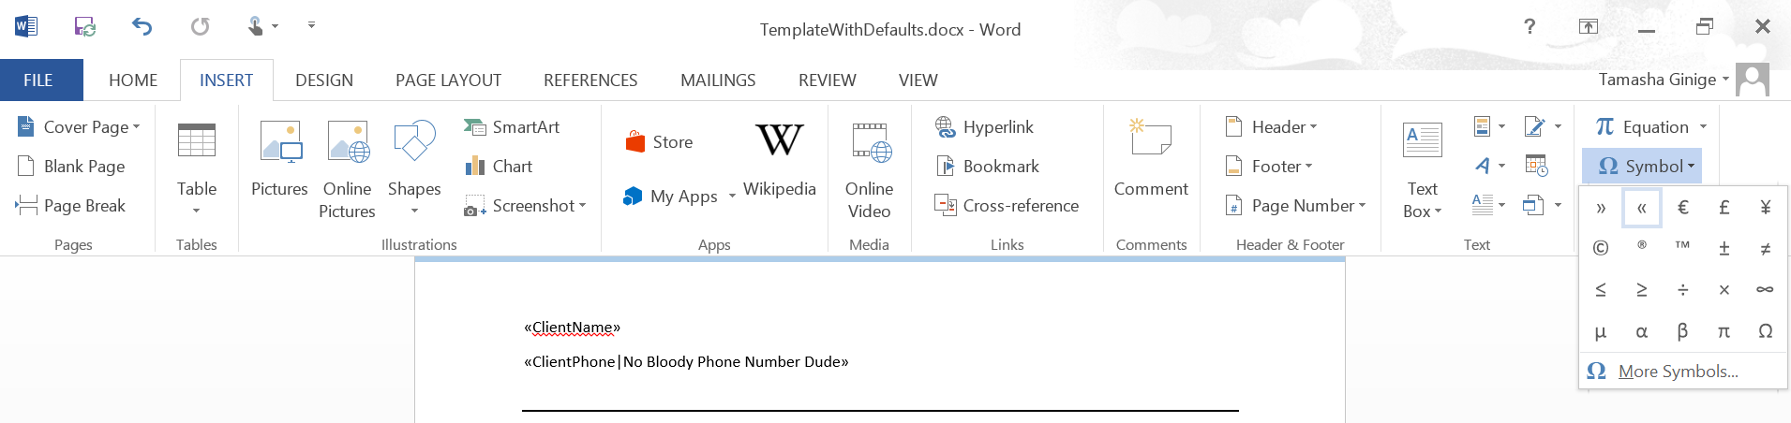
Inserting Fields
Notes:
Creating Fields within the document will enable The HubOne Template Manager to generate client specific data from Xero Practice Manager.
To insert a Field you should:
Select Insert
Select « from the Symbol Tab
Enter the Field Name e.g. Client Name
Select » from the Symbol Tab
e.g. «ClientName»
All the available Fields Types are listed in SharePoint.

Slide 7
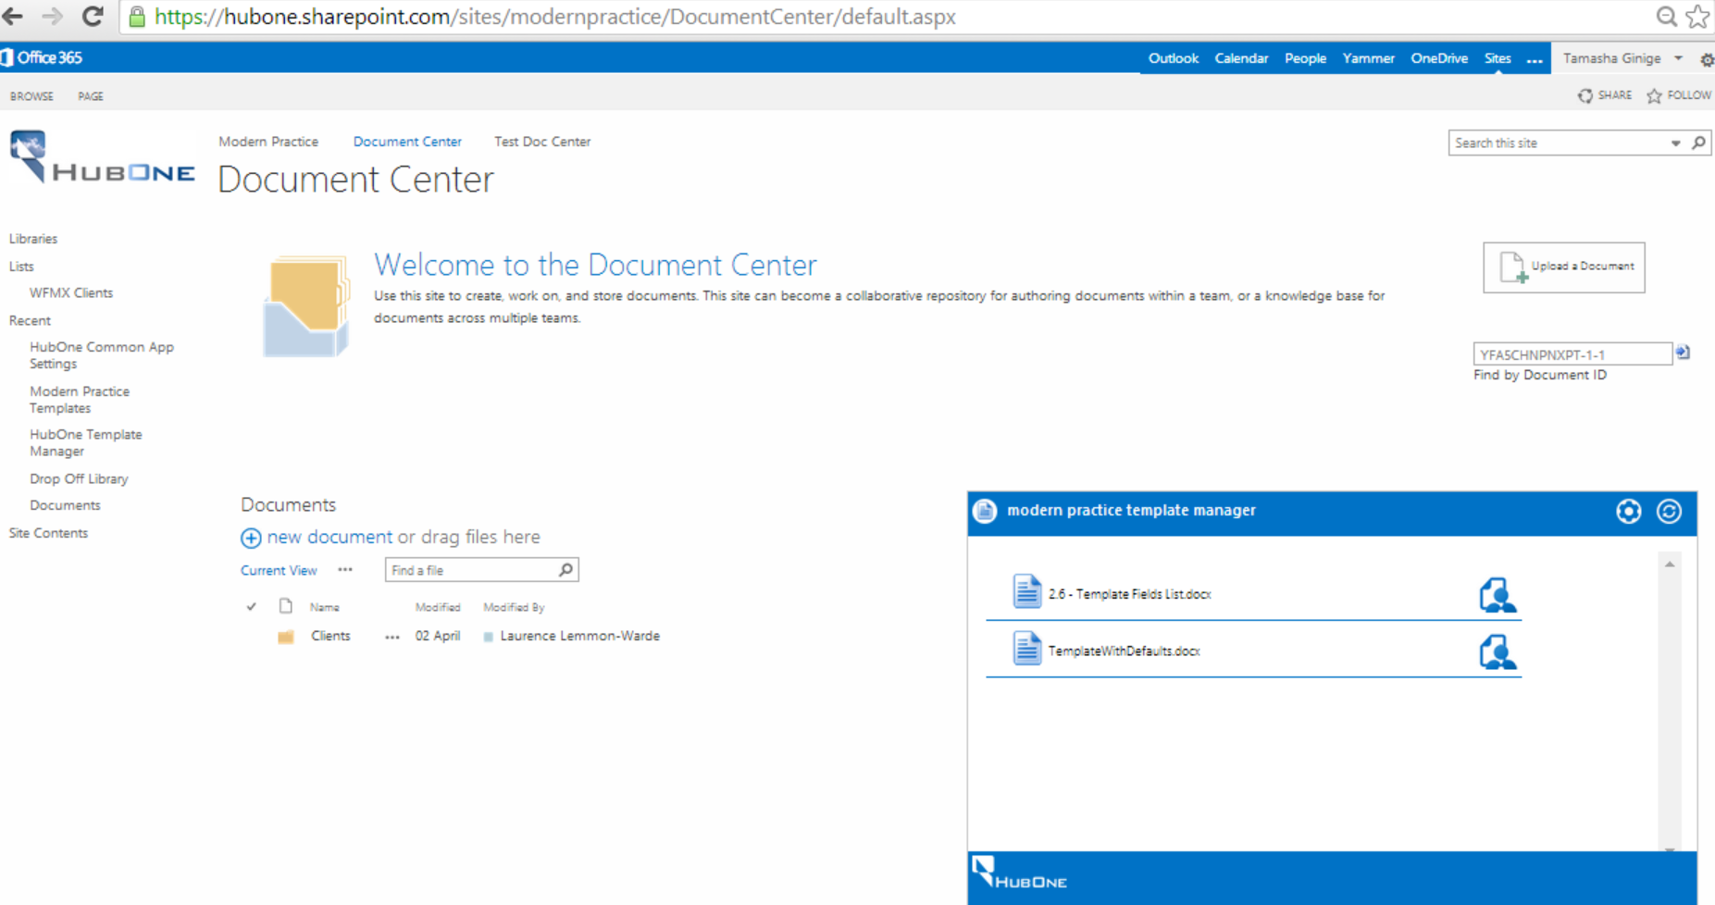

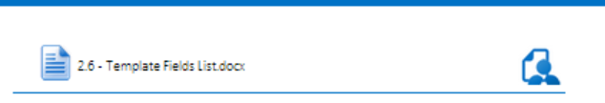
Field Types
Notes:
Open your SharePoint site
e.g. YourDomain.SharePoint.com/sites/modernpractice/documentcenter
Navigate to The HubOne Template Manager
Select the Open Page icon on the left of 2.6 – Template Fields List.docx
This will open a Word document that gives all of the standard Fields to be used in HubOne Template Manager.

Slide 8
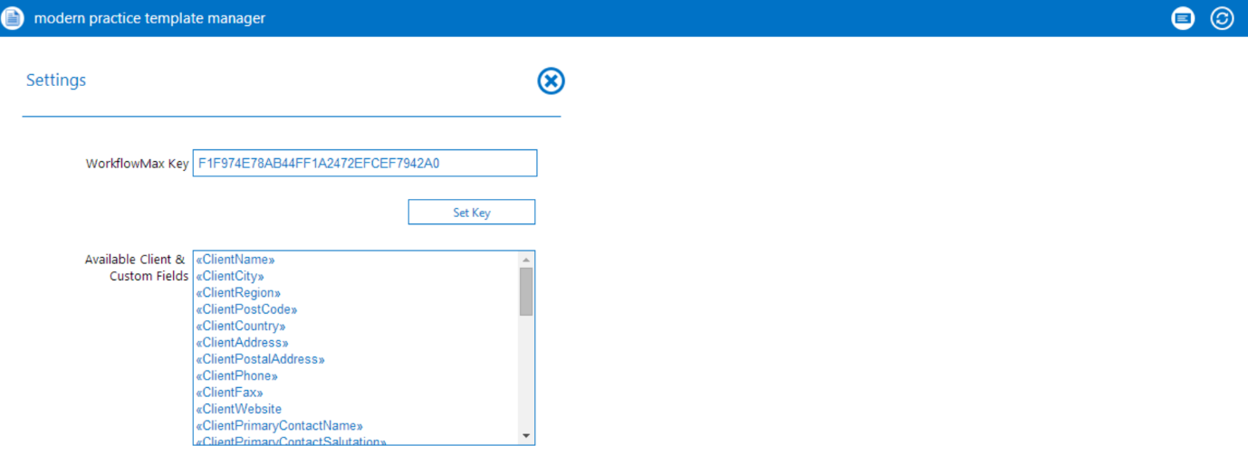
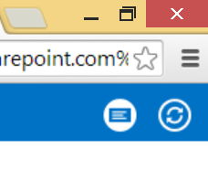
Custom Fields
Notes:
Additional Custom Fields can be found by selecting the Settings icon in the HubOne Template Manager.
Select the Settings icon
This will load the available Clients and Custom fields
You can use any of the Clients and Custom Fields listed.
N.B. Take careful note of the Custom Field names you require as they must be written precisely (including any spacing, capitalisation etc.)

Slide 9
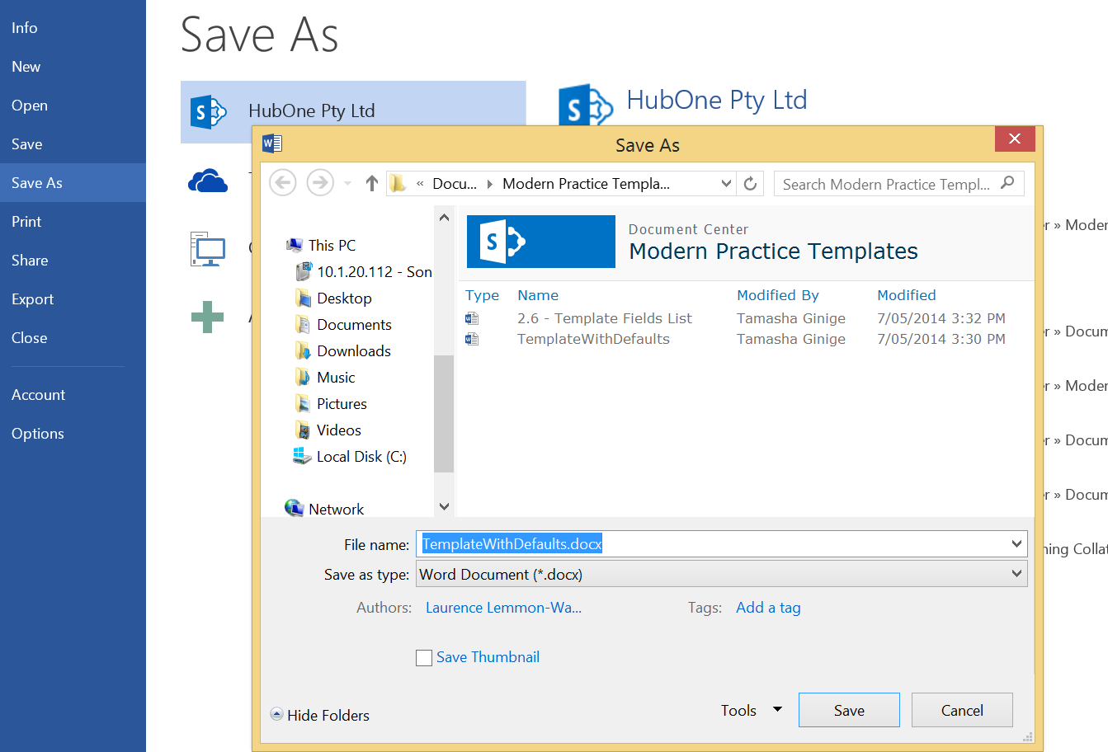
Saving your Document Template to SharePoint
Notes:
Once your document is complete (including all relevant Fields) you can Save the document as a Template.
Select Save As
Navigate to your SharePoint folder Modern Practice Templates
Click Save

Slide 10
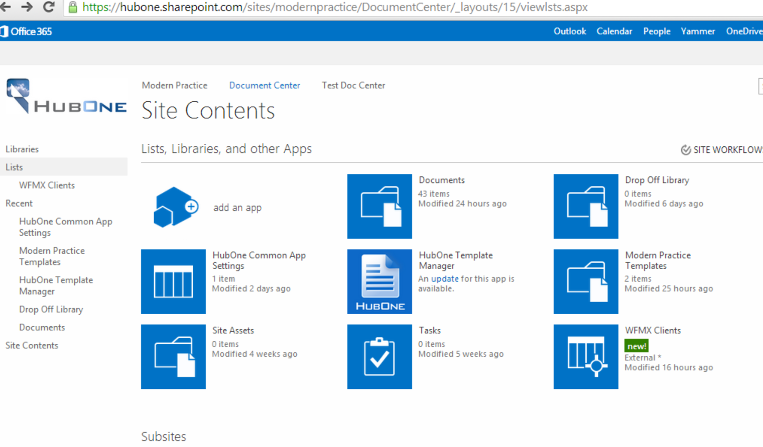
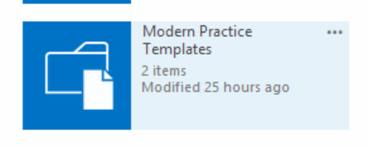

Opening the Document Template in SharePoint
Notes:
Open the Document Center in your SharePoint site
e.g. YourDomain.SharePoint.com/sites/modernpractice/documentcenter
Navigate to the Site Contents folder which will be located on the left pane of the screen
Select the Modern Practice Template folder
Here you will find all the templates that have been added.

Slide 11
End User Guide
Using Document Templates
Notes:
The End User guide is for people who will be creating standardised documents and letters for their organisations based on Document Templates that integrate client data from Xero Practice Manager.

Slide 12
Agenda 2
The HubOne Template Manager
Available Templates
Using The HubOne Template Manager. Part 1
Using The HubOne Template Manager. Part 2
Using The HubOne Template Manager. Part 3
Editing the new document
Edit in Word. Part 1
Edit in Word. Part 2
Edit in Word. Part 3
Edit in Word Online. Part 1
Edit in Word Online. Part 2

Slide 13
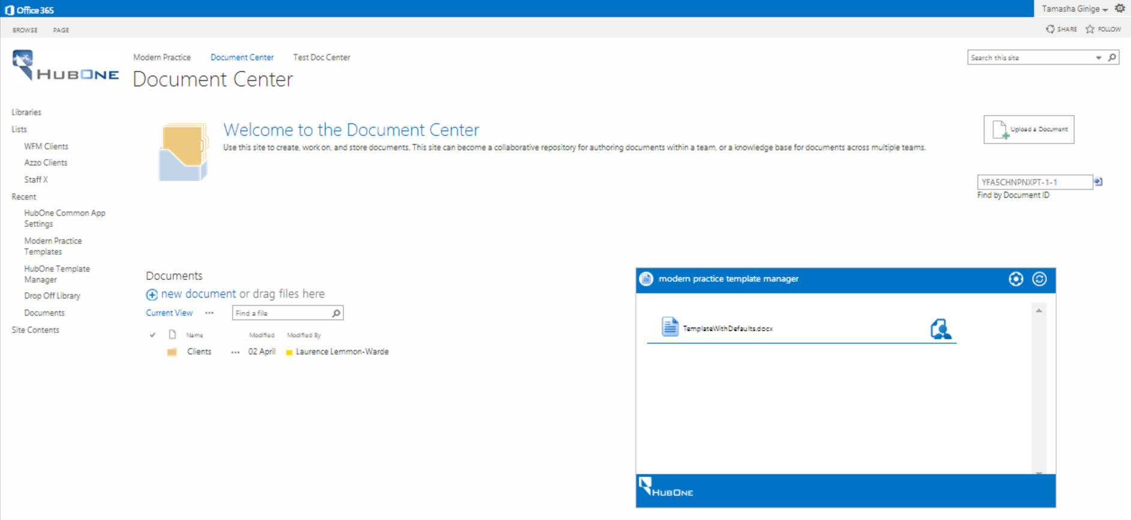
The HubOne Template Manager
Notes:
Open the Document Center in your SharePoint site
e.g. YourDomain.SharePoint.com/sites/modernpractice/documentcenter
The HubOne Template Manager will be located on the bottom right of the screen.

Slide 14
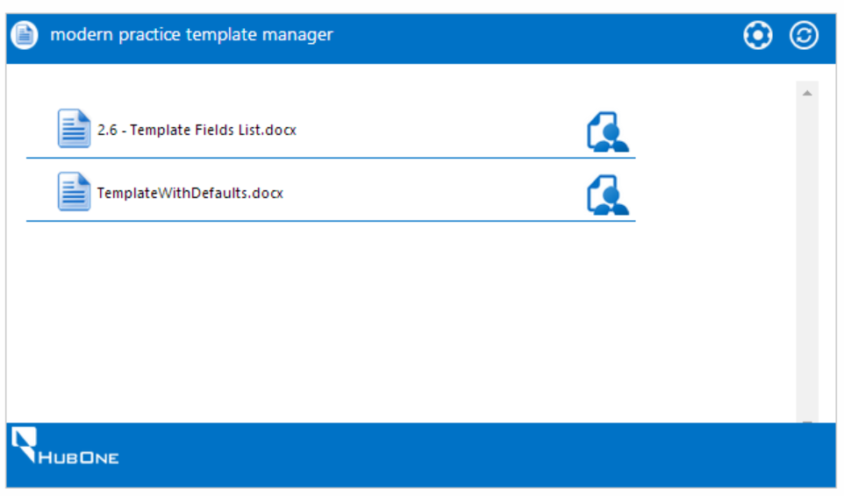
Available Templates
Notes:
You will see a list of Document Templates that are available for you to use
For the most up-to-date list select the Refresh icon
N.B. The 2.6 - Template Fields List.docx Document Template is available by default (this Template is used to create new Templates by your Champion)

Slide 15
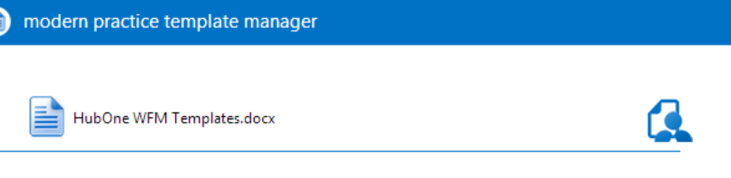
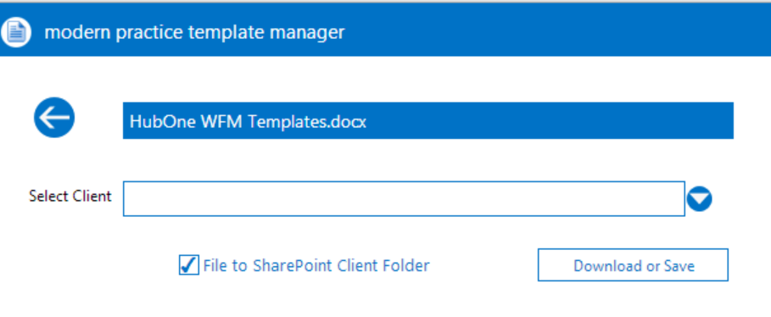
Using The HubOne Template Manager. Part 1
Notes:
Select the Construct icon
This navigates you to the list of your Clients from Xero Practice Manager
Select the Client that you require
The App is defaulted to save a copy of the document you are about to create into the Client’s folder on XPM.
Select Download and Save.
…continue to next slide.

Slide 16
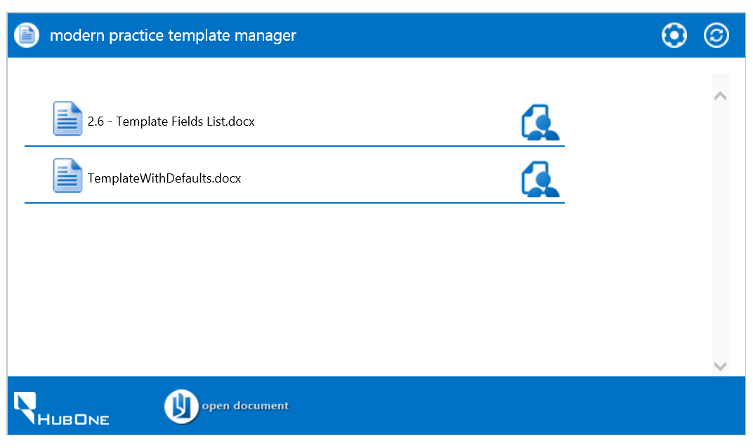
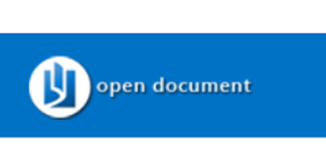
Using The HubOne Template Manager. Part 2
Notes:
Select Open document
N.B. Your may receive a warning pop up – Select Allow
…continue to next slide.

Slide 17
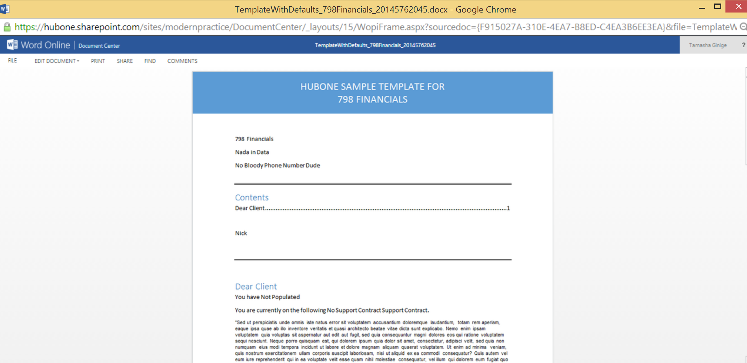
The HubOne Template Manager. Part 3
Notes:
The document will open in Word Online with the contents of the original Template and Client specific data.

Slide 18
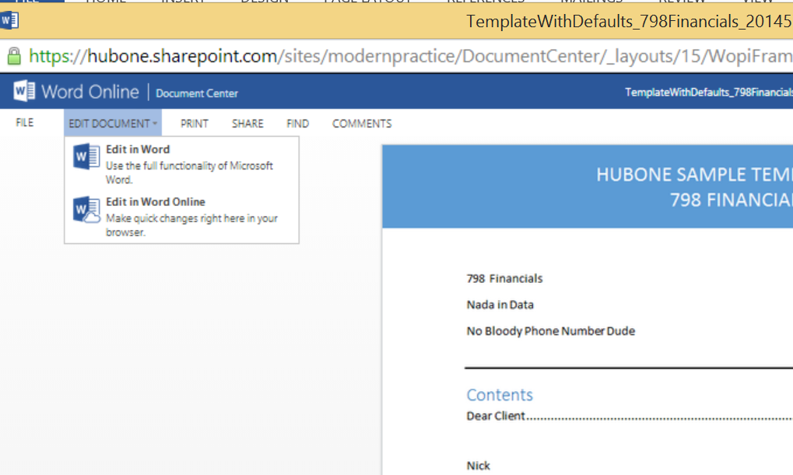
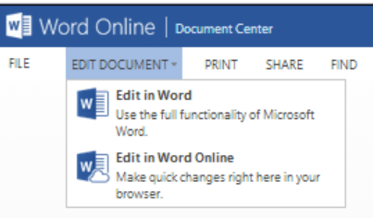
Editing the new document
Notes:
Select Edit Document from the tool bar
Select either Edit in Word or Edit in Word Online
N.B.
- Edit in Word if you are making large changes to the document
- Edit in Word Online if you are making small or quick changes

Slide 19
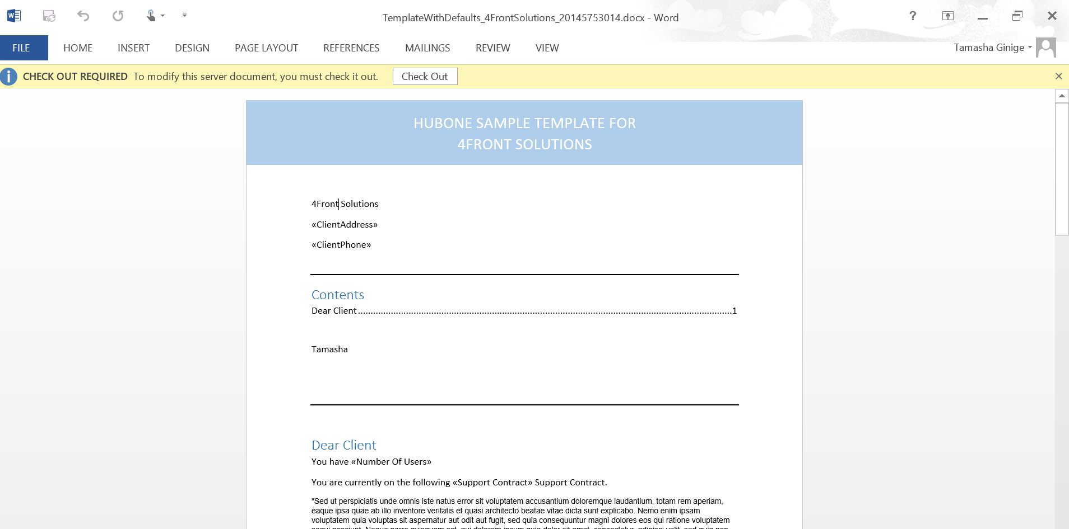
Edit in Word. Part 1
Notes:
When editing in Word you will be prompted to Check Out the document.
Select Check Out
Edit the document as necessary.
…continue to next slide.

Slide 20
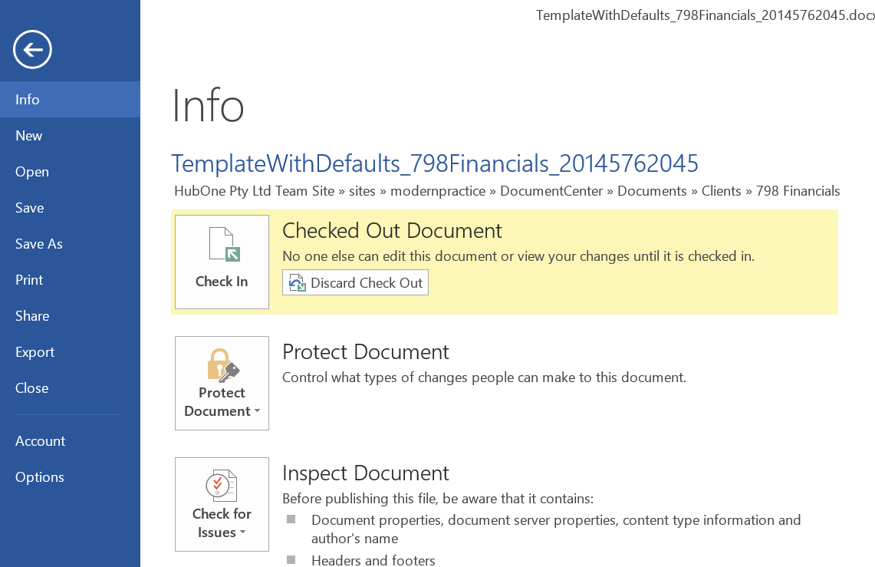
Edit in Word. Part 2
Notes:
Select File
The “info” window will appear
You can either Check In the document with your changes or Discard your Check Out which will not save any of your changes.
If you are happy with the changes you have made select Check In.
…continue to next slide.

Slide 21
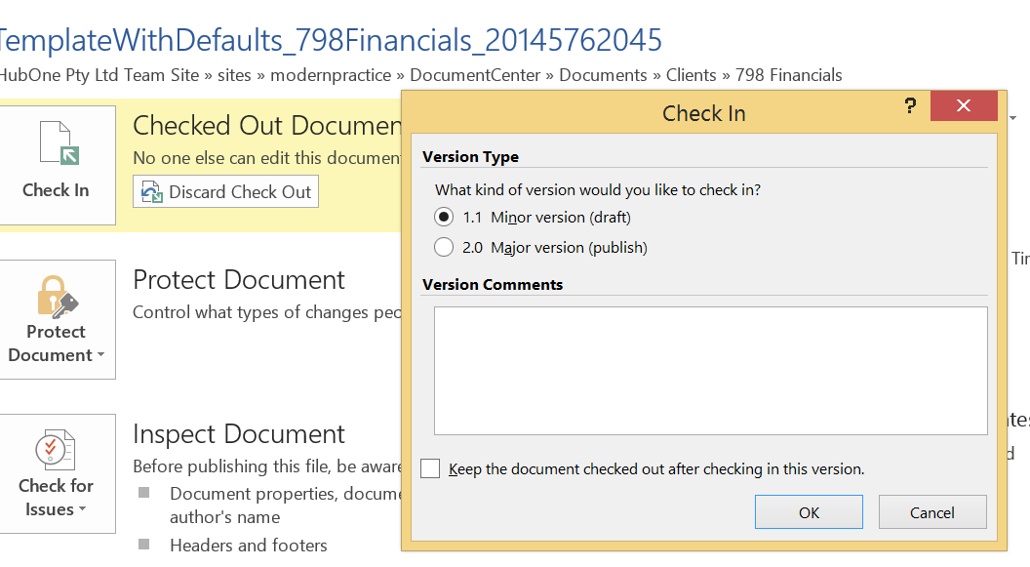
Edit in Word. Part 3
Notes:
The option to Check your document in as Minor or Major Version will appear
Select Minor version (draft) if you plan to continue editing the document
Select Major version (publish) if the document is finished
The document will save as a Checked In version within the Clients folder.

Slide 22
Edit in Word Online. Part 1
Notes:
When editing in Word Online you will be prompted to Check Out the document or Open In Reading View.
Select Check Out
Edit the document as necessary.
…continue to next slide.

Slide 23
Edit in Word Online. Part 2
Notes:
Select File
The “info” window will appear
You can either Check In the document with your changes or Discard your Check Out which will not save any of your changes.
If you are happy with the changes you have made select Check In.

